Slide 1
Automatic Testing of Complex Web Application Using Hierarchical Selenium Framework
Guangyu Lin & Xiangkun Dai

Slide 2
Goal & Approach
Testing real web applications:
Search Engine: Google, Bing, Baidu
Email Services: Gmail, Outlook.
Hierarchical Framework to achieve it!

Slide 3

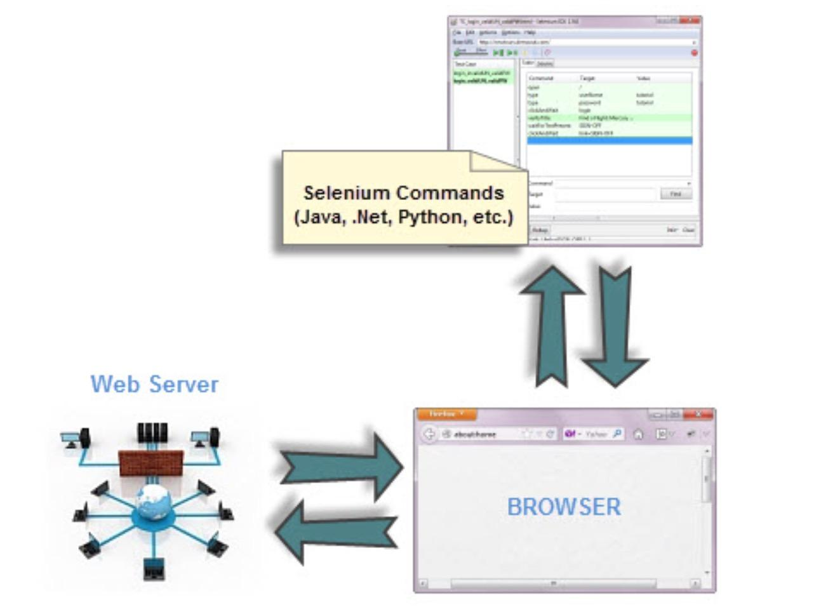
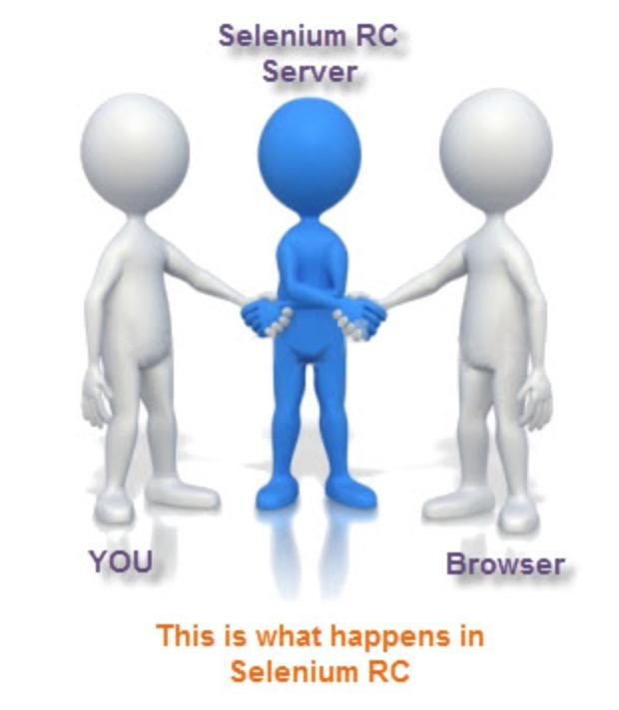
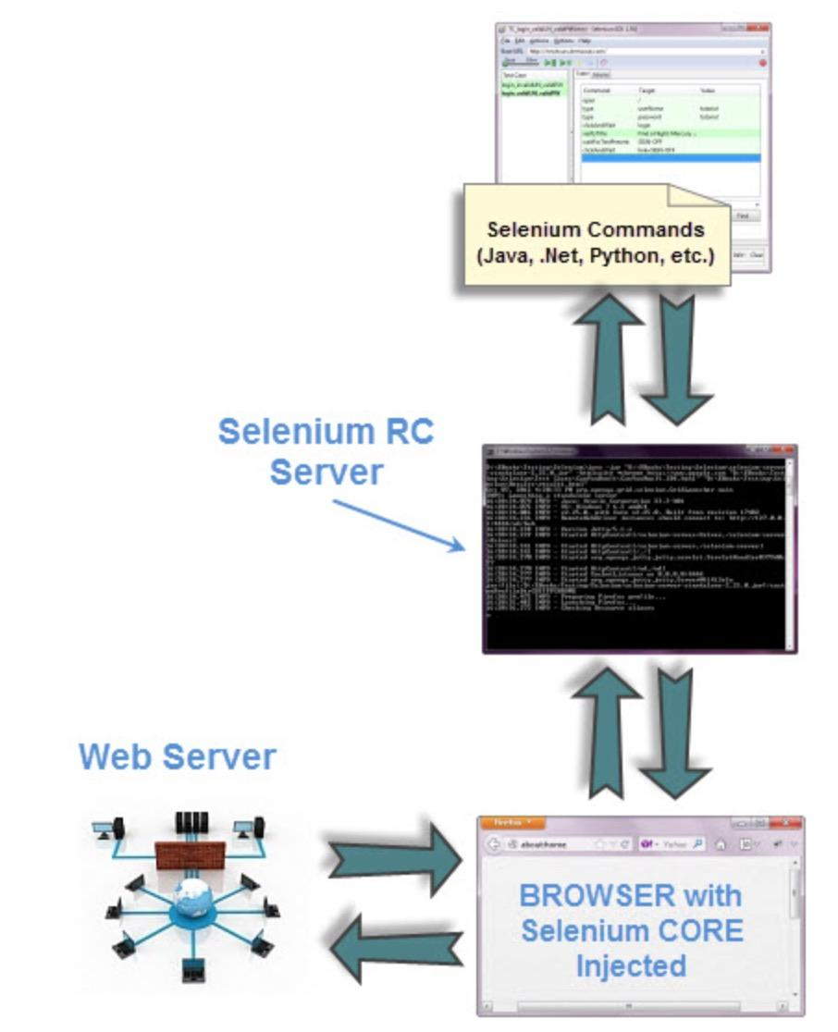
Selenium-RC V.S. WebDriver
WebDriver drives the browser directly using the browser’s built in support for automation.
Selenium-RC worked the same way for each supported browser. It ‘injected’ javascript functions into the browser when the browser was loaded and then used its javascript to drive the application under test(AUT) within the browser.

Slide 4
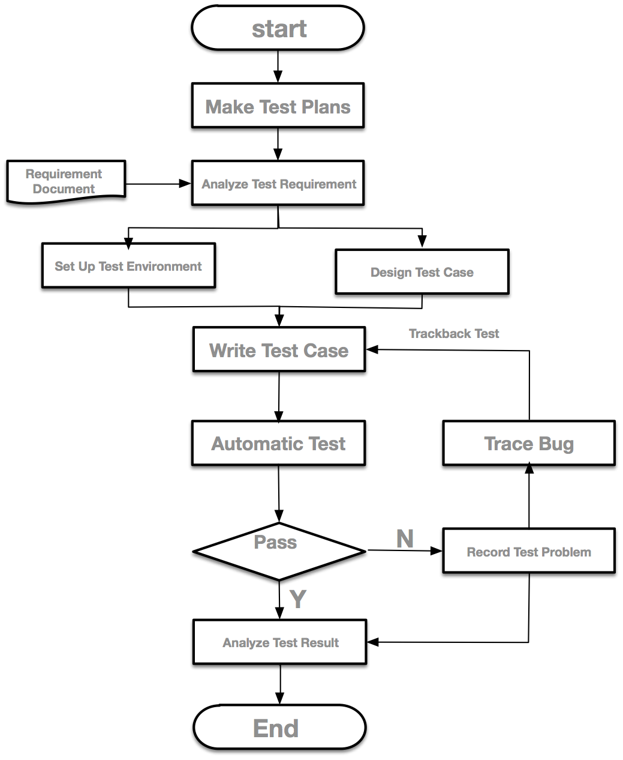
Procedure of Automatic Testing
Make test plan
Analyze test requirement
Design test case
Set up test environment
Write test case
Trace bug

Slide 5
Tricky in Practice
Design: Partition of input domain
(Too many possibilities)
search/login box: null, valid, not valid?
verify: find something?
button: clicked, not clicked?
Implementation: Dynamic locating information
Notes:
Dot?

Slide 6
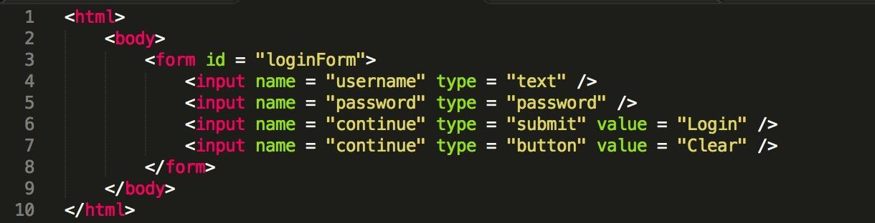
Element Locators
Xpath, most flexible locator:
//form[@id=‘loginForm’]/input[1], locating the first input element under the form with id ‘loginForm’.
still has problems..

Slide 7
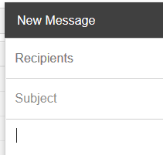
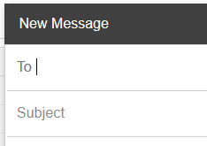
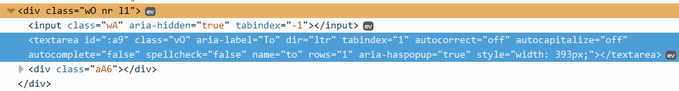
e.g. Different ToBox

Slide 8
Common Selenium Commands
open | verifyTable
click/clickAndWait | waitForPageToLoad
verifyTitle/assertTitle | waitForPageToLoad
Command | Target | Value
verifyText | //table/tr/td/div/p | This is my text and it occurs right after the div inside the table
verifyElementPresent | //div/p/img
verifyTextPresent | Marketing Analysis
Notes:
draft

Slide 9
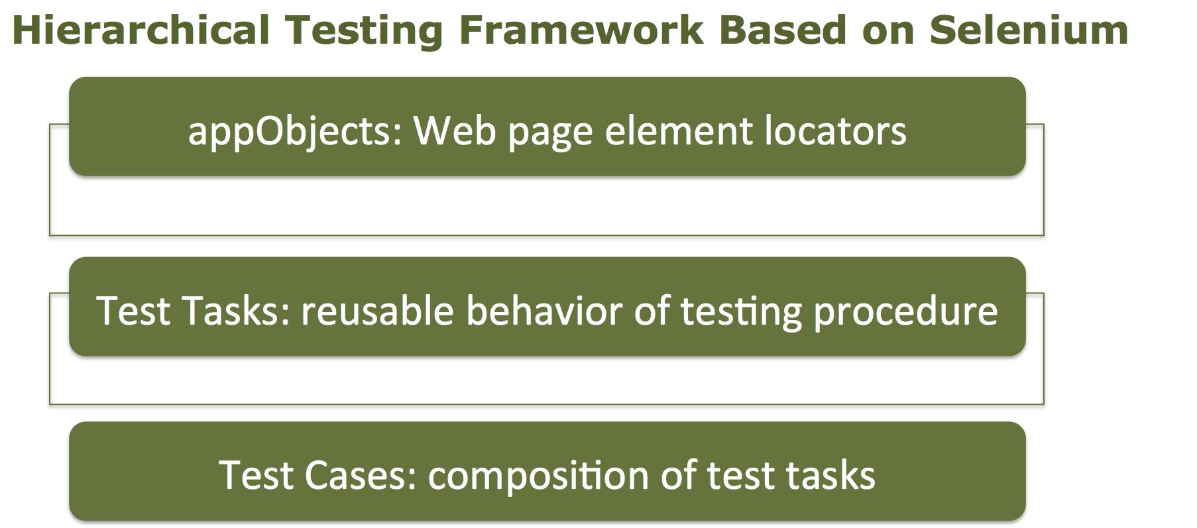
Hierarchical Testing Framework
Notes:
In order to test several Web elements, we construct a hierarchical framework to take advantage of reusability. There are three levels in this framework: appObjects, tasks, and test cases.
each Test Cases is consisted of several reusable test tasks. Test tasks can complete homogenous but different behaviors by passing distinct parameters. AppObjects level, located under Test Tasks, includes locators information in Web pages to be tested.

Slide 10
Decomposition of Tasks
Search Process | Email Login | Email Sending | Email Deleting | Email Searching
search keywords search button verify the results page | input email address input email password login button verify the results | email login process compose button input sending information(receiver address, subject, body) send button verify the result page | email login process checkout deleted item delete button verify the total mail | email login process search keywords search button verify the result page
Notes:
before each click, test existance

Slide 11
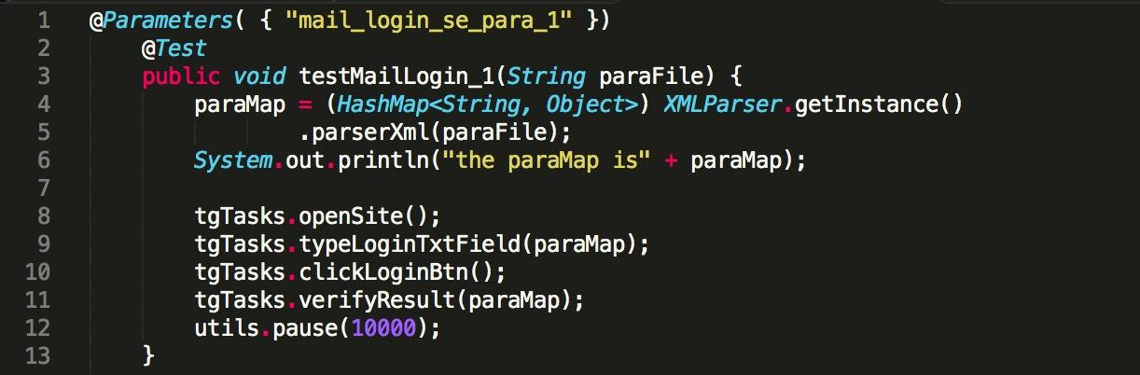
Implementation of Test Cases
Notes:
Test Cases, which are a collection of test procedures, can be achieved by calling the number of Test Tasks. In a hierarchical Selenium test framework, Test Cases is in accordance with the requirements of calling the existing Test Tasks.

Slide 12
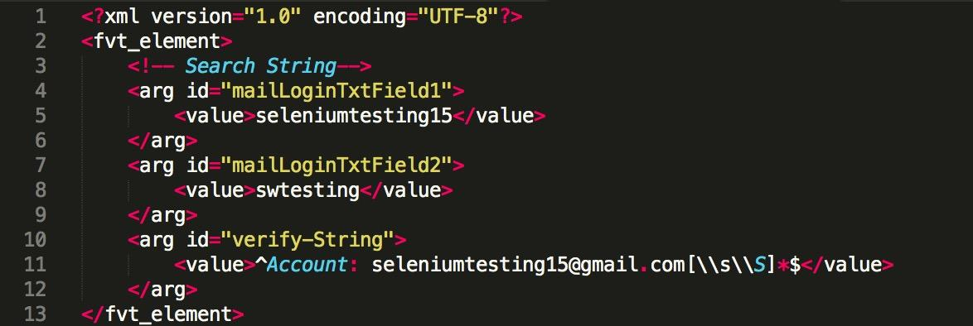
Parameter Parse and Parameter
Notes:
It is worth noting the paraMap parameters in two piece of codes above. The hash table is given by the parameter file parser which we defined. The parameter mechanism of TestNG makes it flexible for Test Cases to specify the parameter file to drive different Test Cases.
“<fvt_element>” is in the outermost layer, and sub-elements within it are as specific parameter values. “<arg>” represents a page element and its corresponding input. We provided a parser to parse these parameter files.

Slide 13
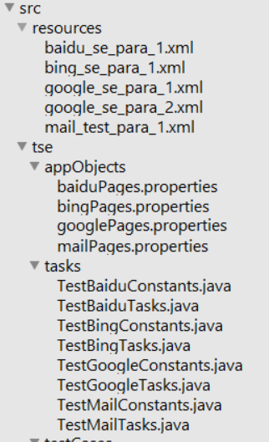
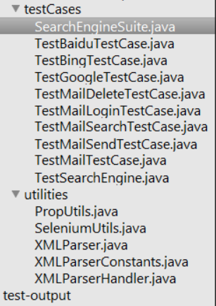
Source Code Structure
We organize our work logically into a three-level structure. Parser and XML files are implemented outside the test suite.

Slide 14
Let’s test them!
Demo: select 5 cases

Slide 15
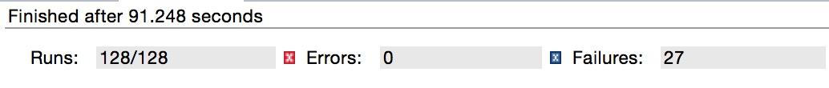
Compare with Homework
When test minandmax.html with minWebTestSuite.java
Homework:
Make changes in original file
Hierarchical Framework:
Add Corresponding XPath locators(Shot lines and Easy)
Add a Click Method to test tasks(Easily to reuse)
Call test tasks in test case(Easily to add)

Slide 16
Compare with Homework
Homework:
Test simple web application
Our Project:
Test complex web application
Hierarchical testing framework
Flexible management and call test
Reusability
Maintainability

Slide 17
Conclusion & Future work
Selenium: Web testing.
Hierarchical framework:
More powerful,
Strong reusability.
High maintainability
Bromine: manage test cases and test suite.

Slide 18
Thank you!
Q & A

